Slide 1
The 3Rs Recruit, Retain, Recognize
Youth Volunteer Life Cycle Toolkit
Exploring the Halton Youth Initiative project findings and examining authentic youth engagement practices

Slide 2
Agenda
Recruit
Retain
Recognize
Expanding Possibilities – what next?
Halton Youth Initiative – co-creating a model for Authentic Youth Engagement with youth and community partners

Slide 3
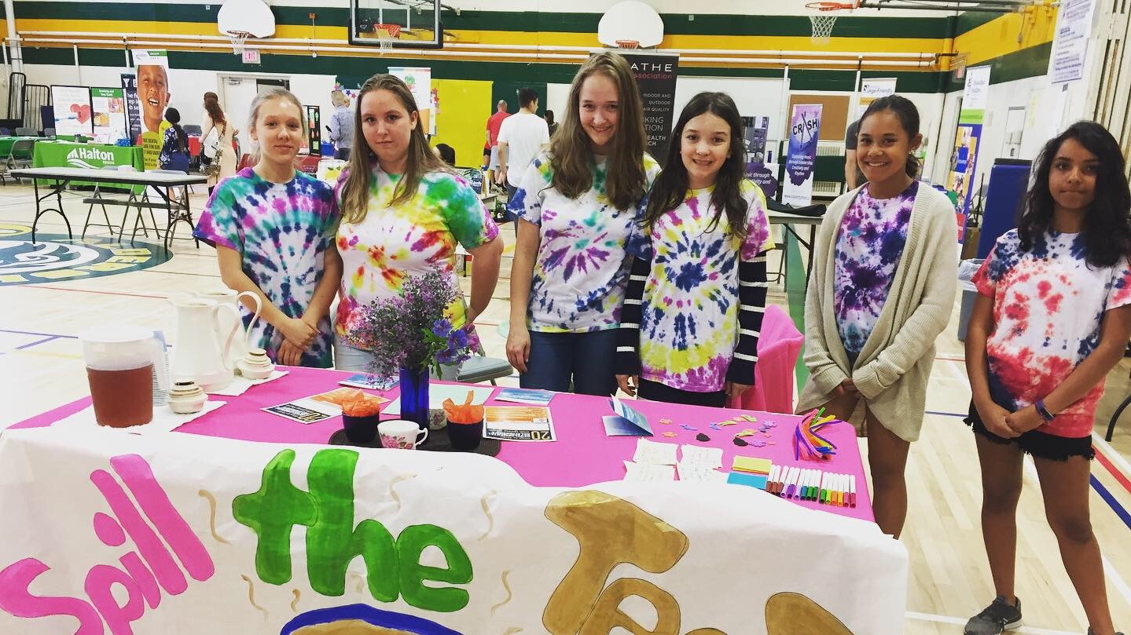
Recruit
What are the best ways to promote a volunteer opportunity to youth?
Social Media Posts
Share posts with opportunities in other organizations
Community databases that share opportunities
Halton Youth Initiative – co-creating a model for Authentic Youth Engagement with youth and community partners

Slide 4
Recruit
Successful listings on social media:
Emphasize youth voice
Provide opportunities to make a difference
Provide all of the major information needed
Use buzz words like “opportunity” and “volunteer hours”
Outline what can be learned
Indicate if youth can volunteer with friends
Create opportunities to meet like-minded individuals
Halton Youth Initiative – co-creating a model for Authentic Youth Engagement with youth and community partners

Slide 5
Recruit
Things to remember:
Promote opportunities to younger students
Youth are keen on learning new skills - be sure to outline the skills youth can learn
Halton Youth Initiative – co-creating a model for Authentic Youth Engagement with youth and community partners

Slide 6
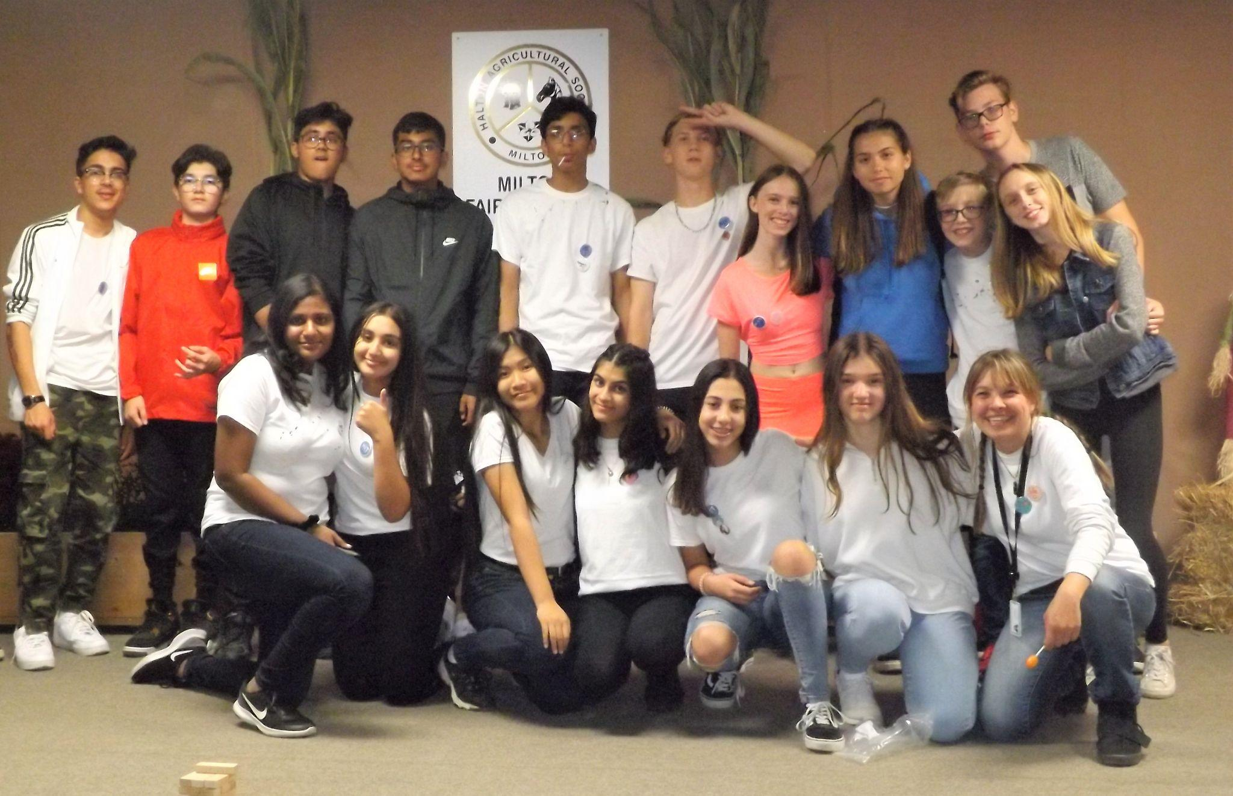
Retain
What do youth look for in a volunteer experience?
An opportunity that will give youth a new experience or bring them out of their comfort zone
Halton Youth Initiative – co-creating a model for Authentic Youth Engagement with youth and community partners

Slide 7
Retain
What aspects encourage youth to stay involved?
A sense that they are making a positive impact
A chance to meet new people and build relationships
Being surrounded by people who encourage them and challenge them to achieve their goals
Halton Youth Initiative – co-creating a model for Authentic Youth Engagement with youth and community partners

Slide 8
Retain
Keys to retaining youth volunteers:
Get youth out of their comfort zone
Provide opportunities to have an impact on their community
Take the time to build relationships
Halton Youth Initiative – co-creating a model for Authentic Youth Engagement with youth and community partners

Slide 9
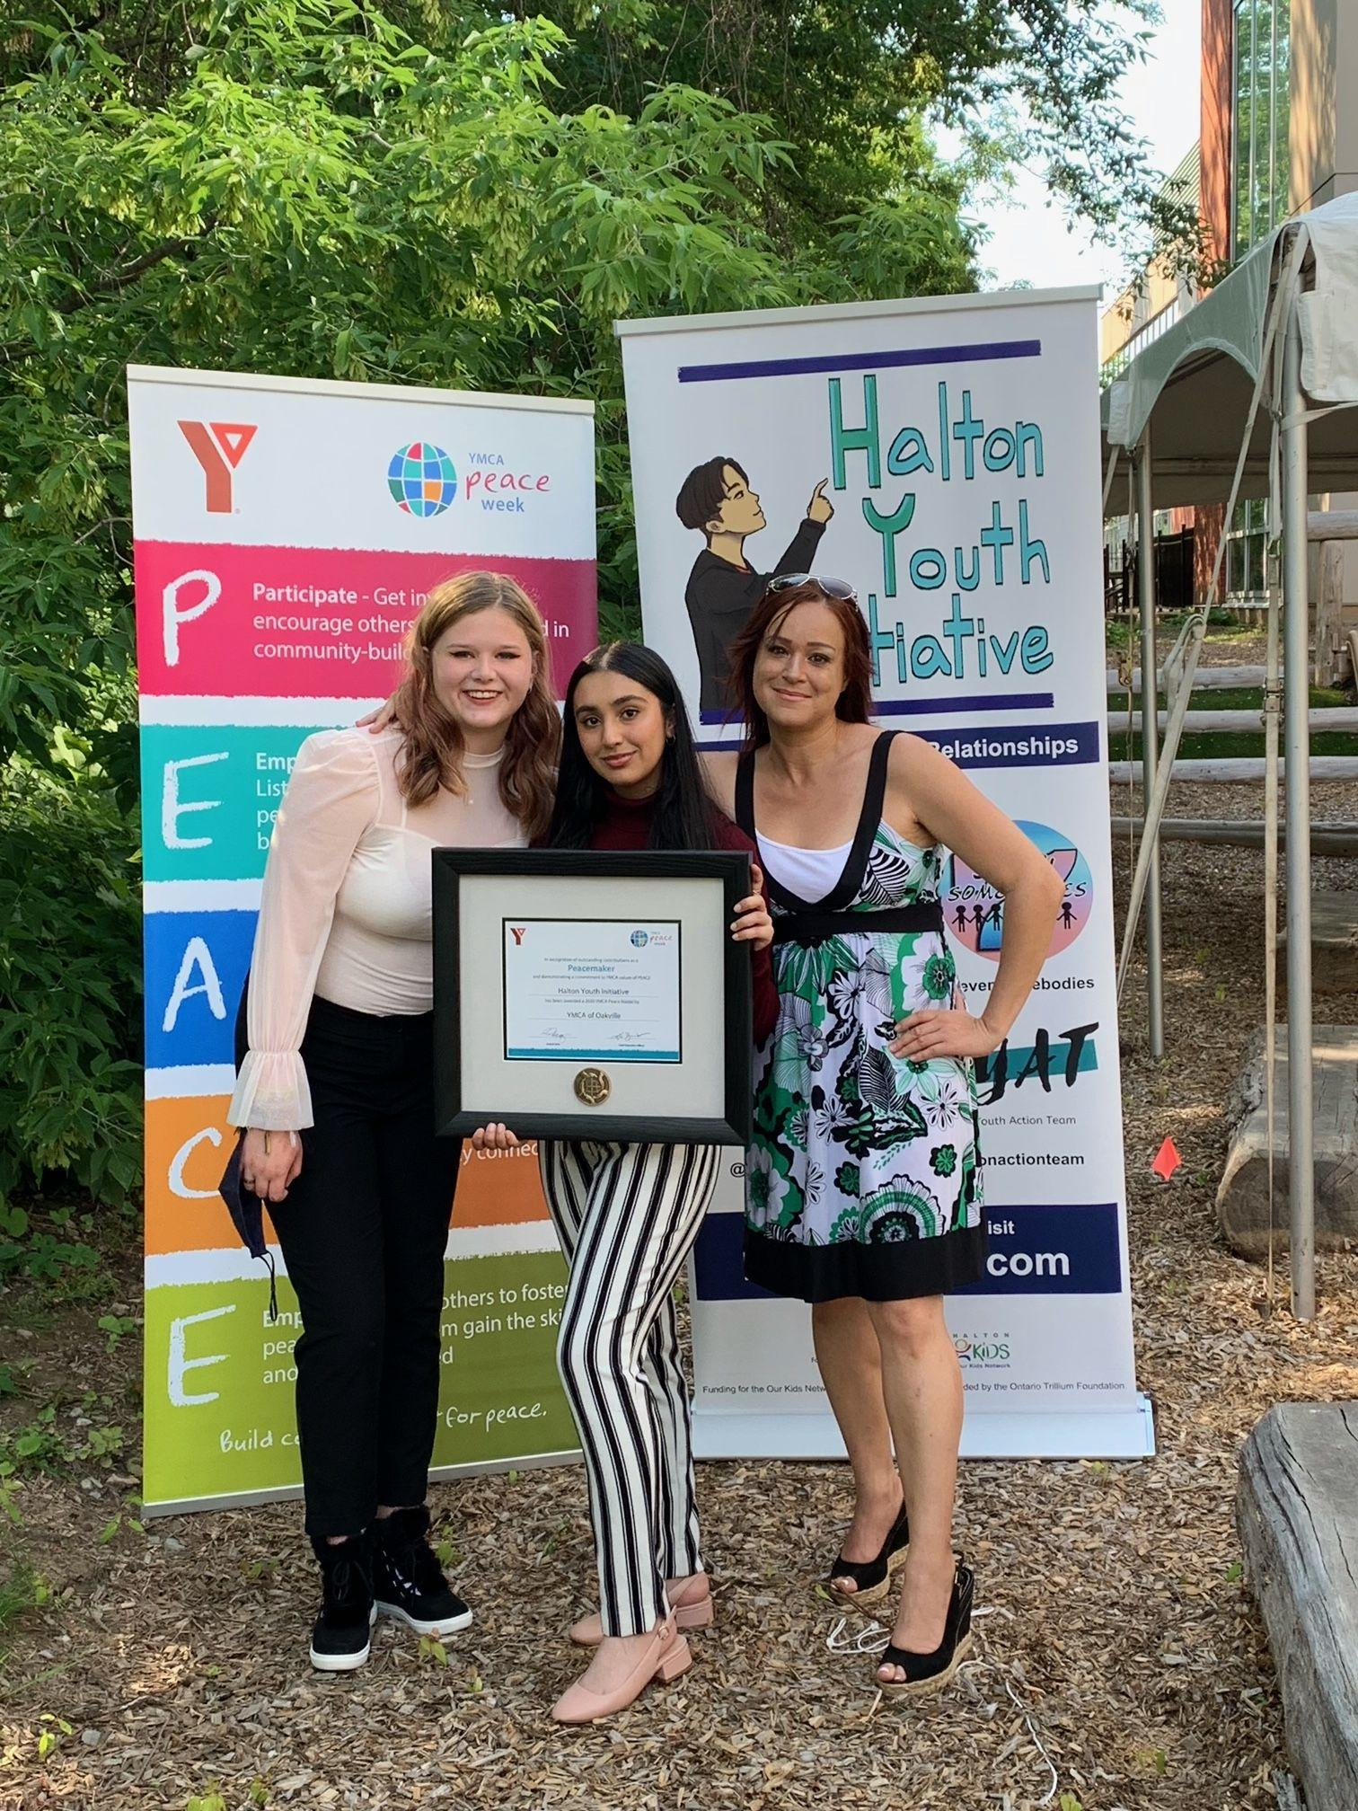
Recognize
What are the best ways to recognize youth who volunteer?
Events
Awards
Reference letters
Acknowledgement
Leadership opportunities community
Halton Youth Initiative – co-creating a model for Authentic Youth Engagement with youth and community partners

Slide 10
Things to remember about the Youth Volunteer Life Cycle:
Use social media to promote opportunities
Promote opportunities to younger students
Youth look for new experiences that bring them out of their comfort zone
Youth volunteers want to have a sense that they are making a difference
Recognize young volunteers in a variety of ways
Youth prefer ongoing opportunities
Provide constructive feedback to youth volunteers
Halton Youth Initiative – co-creating a model for Authentic Youth Engagement with youth and community partners

Slide 11
Expanding Possibilities
Review Practice Brief for further resources
What stage of the Youth Volunteer Life Cycle is your organization really good at? Why?
How can you use this information going forward to enhance your youth programming?
Halton Youth Initiative – co-creating a model for Authentic Youth Engagement with youth and community partners

Slide 12
Thank you!
We all have a role to play in supporting young people. There is no magic template: show up, be present, and be YOURSELF!
haltonyouth.com

